Slide 1


Securing Container Applications:
A Primer

Slide 2
Setting the Stage
Scope of Container Security Application Security
Securing Your Container Image Runtime Security
Kubernetes Speciﬁcs Summary

Slide 3
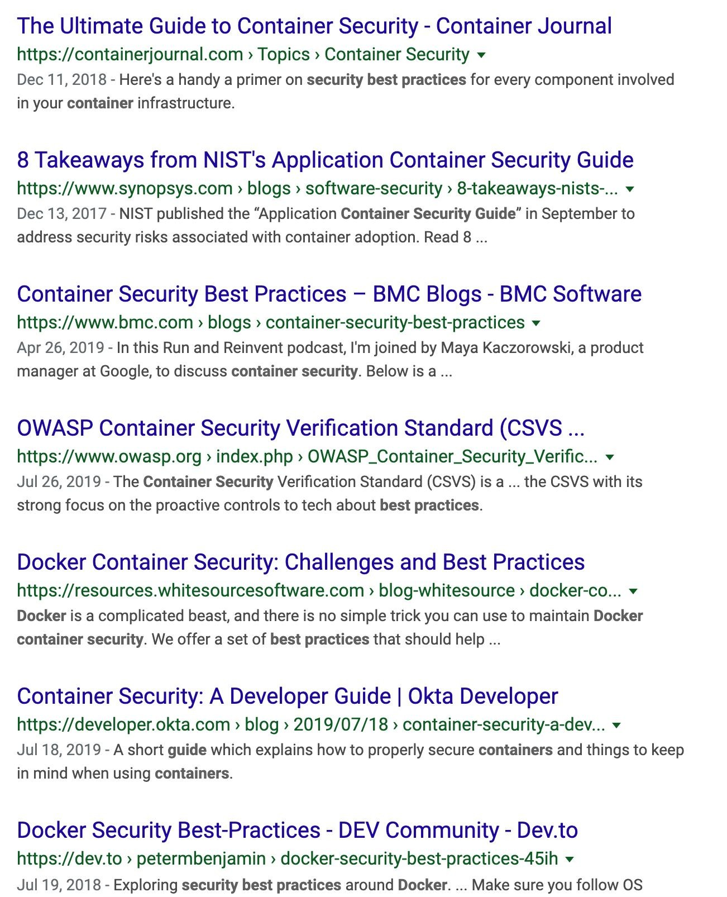
Container Security Scope (hint: it’s big)
Management/Control plane
Networking
Host OS
Image security, provenance
Runtime security/isolation

Slide 4
What We Won’t Cover
Hardening your host OS Hardening your cluster Conﬁguring container runtimes Securing network trafﬁc

Slide 5

Application Security
I want my application to be secure from potential exploits in my code or code I depend on. I want my application to not misbehave in ways that impact the host system I run on or other applications hosted in a shared environment. I want my application to be resilient to failure conditions and have reasonable protection from denial of service outages.

Slide 6
Container Application Security
Tools, conﬁguration, and runtime capabilities provided via the container ecosystem used to wrap an existing security-focused application to provide more isolation, protection, and overall security for your code running inside a container.

Slide 7
Image Security - Contents
Never include secrets (passwords, API keys, tokens, private keys) in an image!
Container images are not encrypted; anyone with access to the registry or the local system where they are downloaded/unpacked will have access to these secrets
FROM what?
Your starting point is very important; your application and the pieces of a Linux distribution (for Linux containers) are now your responsibility to maintain/manage.
Who maintains it? Who updates it for CVEs? How often do you rebuild on a new base?
Minimize content - fewer packages means less maintenance/security issues
Use multi-stage builds to keep build-time dependencies out of your ﬁnal image
Using DockerHub ofﬁcial images? Start with “slim” or “alpine” tagged variants
Use “FROM SCRATCH”
Your ﬁles are added to an empty container ﬁlesystem
Requires ability to build a static binary with no dependencies
Requires some knowledge of how to assemble base ﬁlesystem (e.g. SSL root certiﬁcates)

Slide 8
Image Security - Build Concerns
Image signing
TUF/Notary are CNCF projects; Docker-speciﬁc implementation as “Docker Content Trust”
Cons: Notary project health concerns/feature requests; some cloud providers looking at OCI for possible standardization (very early discussions)
Pros: can be used to enforce provenance of an image through a set of gates in your devops environment (e.g. test, scanning, promotion to prod)
Image scanning (larger topic: CI/CD pipelines)
You need visibility into whether your image has unpatched contents when using a Linux distribution. Some vendor-speciﬁc scanners can look beyond CVE content at other potential runtime security issues.
A scanner won’t ﬁx your out of date image!
Specify a non-root user
“USER {some-unprivileged-user}” in Dockerﬁle
Rarely does your container need root access to perform its job; don’t run containers as root—it’s adding an unnecessary weakness in your layers of defense

Slide 9
Runtime Security - Containing your Workload
Resource Limits
The essence of Linux containers are based on two key Linux features: namespaces + cgroups. Linux control groups (cgroups for short) are used to limit resources to any process in Linux
You can control memory, I/O bandwidth, and CPU usage with standard cgroups
The system call “attack surface”
Your application, whether you know it or not, is using Linux system calls (syscalls)
If you know speciﬁcs about your application’s level of capabilities needed, you can drastically reduce the “attack surface” of the entire system call table (and related privileges)
Administrative privilege
The “USER” speciﬁed in the Dockerﬁle can be overridden at runtime. It would be best to have runtime limitations to not allow images to run as root, or to whitelist some speciﬁc administrative tools/applications which cannot be changed
User namespaces are a larger hammer to prevent this, but have not arrived in Kubernetes yet
Read-only root ﬁlesystem

Slide 10
Runtime Security Focus
01
RESOURCES
As limited as is feasible.
02
ATTACK SURFACE
As small as is possible.
03
PRIVILEGES
The least amount necessary.

Slide 11
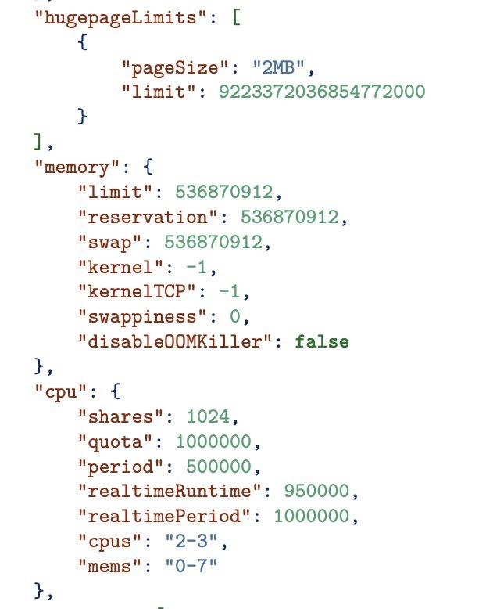
Runtime Security - Resources
Limit memory & CPU
Memory and CPU speciﬁcations are part of the OCI container runtime spec: all OCI-compliant runtimes implement these features
Kubernetes exposes these limits (in a less-granular form) via the Pod speciﬁcation
Limit processes
Pids limit is also part of the OCI spec; this can be important to prevent forkbombs or any other runaway process forking in your container
Limit disk consumption
The OCI spec has I/O bandwidth limitations via cgroups, but not exposed in K8s
Kubernetes has ephemeral disk limitations
Advanced (ops) topic: use a quota-supporting FS
Be cautious with host-mounted ﬁlesystems

Slide 12
Runtime Security - Attack Surface
Linux Capabilities
Linux capabilities are collections of system calls with a similar purpose; they have names like CAP_NET_RAW or CAP_SYS_ADMIN. Some are fairly ﬁne grained and some, like CAP_SYS_ADMIN, might as well be “the new root” as lwn.net called it!
Kubernetes provides a way to drop/add capabilities to a container via the Pod spec
LSMs: AppArmor/SELinux
Linux Security Modules can be complicated to understand, but they effectively provide a “language” to describe a wide-ranging set of permission limits on processes: e.g. speciﬁc permissions (read/write) to ﬁlesystem paths, network socket access, among others
Docker (and other runtimes) have default proﬁles which restrict container permissions
Kubernetes provides support for named AppArmor proﬁles in the spec; however, it is an operational concern to install unique proﬁles onto your worker nodes
SECCOMP (“Secure Computing”)
“Seccomp” support in container runtimes allows you to specify one-by-one which syscalls are allowed for a process. Docker’s default proﬁle removes 44 from the list of 330+

Slide 13
Runtime Security - Privileges
Don’t run privileged containers!
There really isn’t much else to say here: most of the controls discussed here are removed when you enable “privileged” for a container/pod.
Giving CAP_SYS_ADMIN to a container is effectively very similar to root/full privilege
Root/Administrative user
Don’t run containers as root, and don’t give them ways to escalate privilege (various settings in
PodSecurityPolicy can help here)
Make this enforceable via an admission controller which enforces baseline policies
User namespaces will come to Kubernetes at some point and offer a more nuanced way to have administrative privilege only inside the container
Remember that exposing the K8s or Docker (or other runtime) API—e.g. mounting the Docker socket— inside the container is most likely an escalation path to root on the host. There are solutions to most of the historic reasons applications have “reached down” into the container runtime!

Slide 14
Kubernetes: Controlling Resource Limits
Resource Limits
Set per-container in the Pod yaml
Note that not all OCI spec memory/CPU options are exposed in the K8s API speciﬁcation
Limit Processes
Still alpha as of Kubernetes 1.16
Cluster operator must enable feature gate
SupportPodPidsLimit=true, and then pass a
--pod-max-pids integer to kubelet
Limit is ﬁxed per-pod; no customization possible
I/O Bandwidth Limits
The cgroups i/o settings are not exposed here to be set per container.
K8s does offer resource quotas, and QoS features—related but not the same features
apiVersion: v1 kind: Pod metadata:
name: frontend spec:
containers:
name: db image: mysql resources:
limits:
memory: "128Mi" cpu: "500m"
name: wp
image: wordpress resources:
limits:
memory: "128Mi" cpu: "500m"

Slide 15
Kubernetes: Limiting Attack Surface
Capabilities
Set per-container via securityContext ; can add/drop caps by name
AppArmor
Annotations are used to identify AppArmor proﬁles in Kubernetes
Operator must install them on worker nodes; developing new proﬁles? Tools TBD
Seccomp
Also set via annotation, but on PodSecurityPolicy; see upcoming example; not default
apiVersion: v1 kind: Pod metadata:
name: hello-apparmor annotations:
container.apparmor.security.beta.kubernetes.io/hello: localhost/deny-write spec:
containers:
- name: hello

Slide 16
Kubernetes: Reducing Privilege
Non-root user
Use securityContext for containers and pod-level control
Use PodSecurityPolicy to enforce restrictions cluster-wide
Capabilities (privilege related)
Also in securityContext; see example
apiVersion: v1 kind: Pod metadata:
name: security-context-demo spec:
securityContext: runAsUser: 1000
runAsGroup: 3000
fsGroup: 2000 containers:
- name: sec-ctx-demo image: busybox
command: [ "sh", "-c", "sleep 1h" ]
securityContext: allowPrivilegeEscalation: false
runAsUser: 2000 capabilities:
add: ["NET_ADMIN", "SYS_TIME"]

Slide 17
Kubernetes: Cluster Security Enforcement
apiVersion: policy/v1beta1 kind: PodSecurityPolicy metadata:
name: restricted annotations:
seccomp.security.alpha.kubernetes.io/allowedProfileNames: 'runtime/default' apparmor.security.beta.kubernetes.io/allowedProfileNames: 'runtime/default' seccomp.security.alpha.kubernetes.io/defaultProfileName: 'runtime/default' apparmor.security.beta.kubernetes.io/defaultProfileName: 'runtime/default'
spec:
privileged: false
allowPrivilegeEscalation: false
# This is redundant with non-root + disallow privilege escalation:
requiredDropCapabilities:
- ALL
hostNetwork: false hostIPC: false hostPID: false runAsUser:
# Require the container to run without root privileges.
rule: 'MustRunAsNonRoot'

Slide 18
Kubernetes: Applying Container Security
PodSecurityPolicy: enforce many good practices cluster-wide! OpenShift is a good example of a Kubernetes distribution with strong defaults out of the box
Use the Kubernetes secrets implementation to protect sensitive keys, tokens, materials. Vendor tools available as well (Hashicorp Vault), and potentially from your cloud provider
Don’t circumvent security to make your code “easy”: e.g. K8s API access with admin role; mounting container runtime (e.g. Docker) API with full privilege
Have a unique workload requirement (multi-tenancy, untrusted code)? Take a look at RuntimeClass features in Kubernetes to allow custom isolators (gVisor, Kata, Firecracker, Nabla, etc.)
Remember that you need visibility and not simply ﬁre-and-forget security! Logging, audit, vendor tools/open source projects for runtime protection, anomaly detection, etc.

Slide 19
BUT...Container Security is Hard!!
Use a cloud provider
Managed Kubernetes services many times can be created with a set of default tools and policies for strong controls pre-conﬁgured for you
Many managed services integrate with popular vendor tooling
e.g. Twistlock, Snyk, Aqua, Datadog, Sysdig, LogDNA and many others
Use recommended guides and proﬁles publicly available (CIS, NIST, DockerBench, etc.)
Try out emerging tooling
Generate seccomp proﬁles by running your application with BPF tracing:
https://github.com/containers/oci-seccomp-bpf-hook

Slide 20
Resources
PodSecurityPolicy: https://kubernetes.io/docs/concepts/policy/pod-security-policy/
Kubernetes Security Concepts: https://kubernetes.io/docs/concepts/security/overview/ AppArmor documentation: https://kubernetes.io/docs/tutorials/clusters/apparmor/ SELinux documentation:
https://kubernetes.io/docs/tasks/configure-pod-container/security-context/#assign-selinux-labels-to-a-container
Resource controls: https://kubernetes.io/docs/concepts/configuration/manage-compute-resources-container/
Complete list of Linux capabilities: http://man7.org/linux/man-pages/man7/capabilities.7.html

